Slide 1

Data 180
Done by: Elsa Hritz
George Thorp
Paul Florio
Rahma Semma

Slide 2
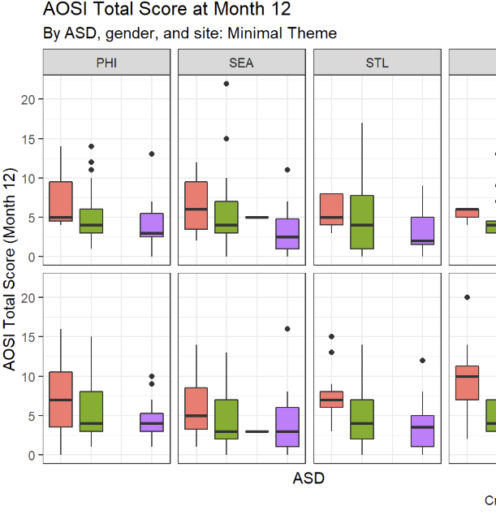
ggplot & Visualization
What is ggplot?
ggplot2 is an R package used for data visualization based on the Grammar of Graphics. It allows us to create complex plots from data in a systematic way.
It builds plots layer by layer using components: data, aesthetics, geometries, and more.
ggplot is known for its clean, elegant visuals and customizability.
Goal of Visualization: Helps us understand patterns, trends, and distributions in data, particularly useful for quantitative data (e.g., numerical data).
Data:https://kmdono02.github.io/Data_Analysis_with_R_IBIS/creating-graphs-with-ggplot2.html

Slide 3
The Grammar of Graphics
ggplot is based on the Grammar of Graphics, which consists of:
Data: The dataset being used.
Aesthetics (aes): Mapping data to visual properties (x, y, color, size).
Geometries: Types of plots (e.g., geom_point(), geom_line()).
Statistics: Summarizing data with statistical transformations.
Coordinates: How the data is mapped on the plot (e.g., coord_cartesian()).
Facets: Dividing plots into subplots based on a factor.

Slide 4
Types of Visualizations in ggplot2
Scatterplot: Shows relationships between two quantitative variables. Helps visualize correlation and trends.
Histogram: Displays the distribution of a single quantitative variable. Shows skewness, spread, and central tendency.
Barplot: Represents categorical data and counts of categories. Useful for comparing discrete groups.
Boxplot: Summarizes the distribution of a dataset using five key statistics: min, Q1, median, Q3, and max.

Slide 5
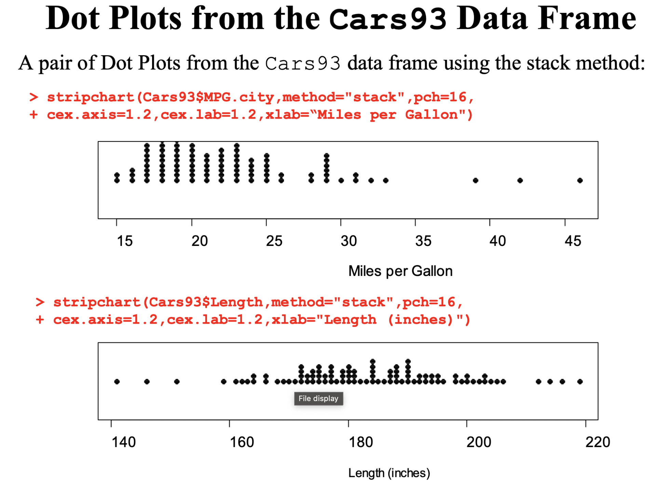
Visualizing Quantitative Data (Dot plot)
Dot Plot Basics - Ideal for displaying individual data points in a simple, clear way.
Interpretation:
Shows frequency of values.
Highlights clusters, gaps, and outliers in the dataset.
Useful for small datasets with a focus on distribution.

Slide 6
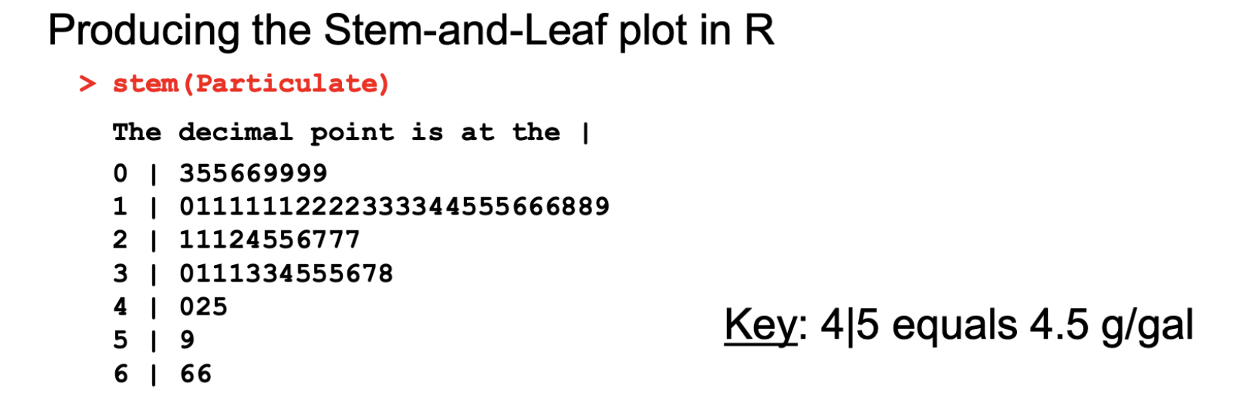
Stem-and-Leaf Plot
A way to organize numerical data while retaining the original values.
Interpretation:
Displays data in a way that shows the distribution.
"Stem" represents the leading digit(s), and the "leaf" represents the trailing digit(s).
Easy to identify the shape of the data, such as symmetry, skewness, or clusters.
Useful for small to medium datasets, allowing for quick identification of trends and outliers.

Slide 7
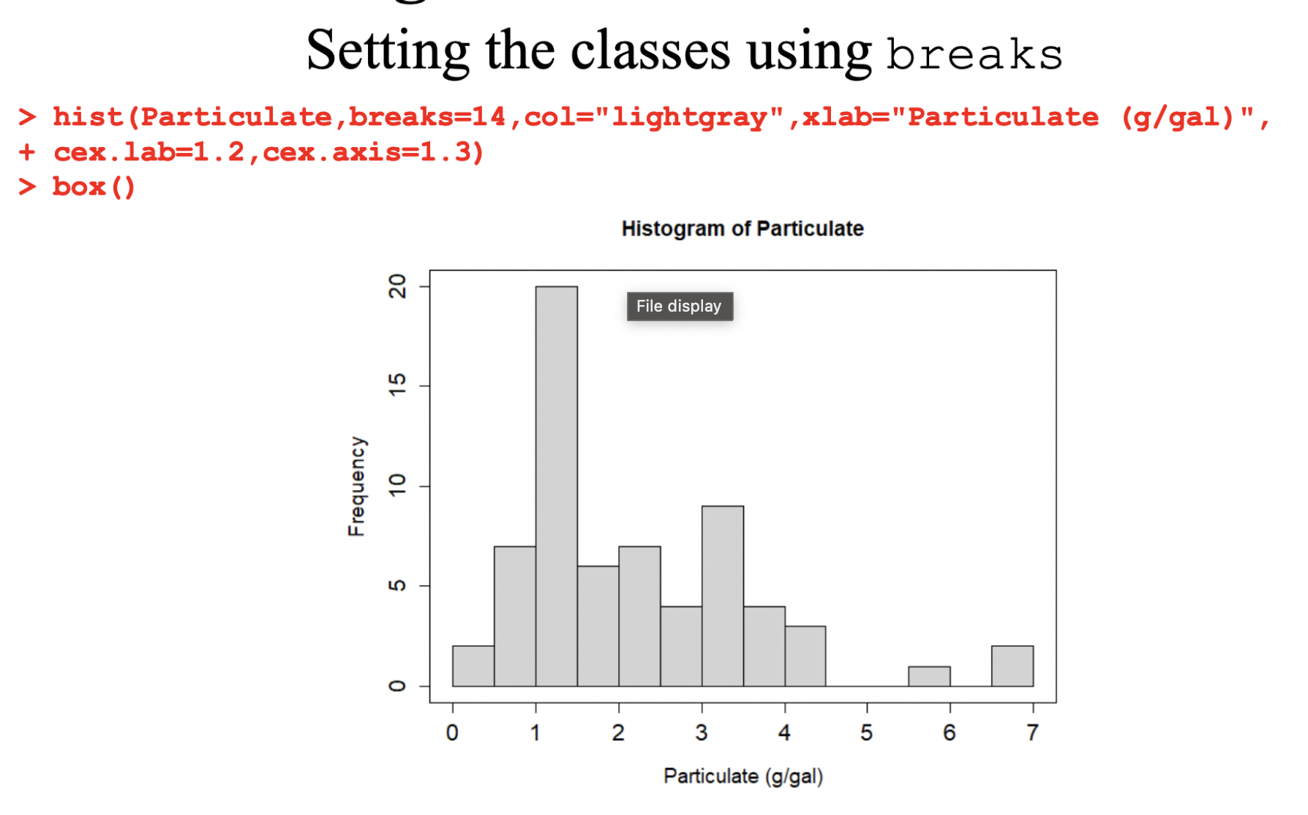
Histogram
Ideal for showing the distribution of a continuous variable.
Key Features:
Data is divided into bins or classes (number of bins can affect the interpretation).
Displays the frequency of data within each class.

Slide 8
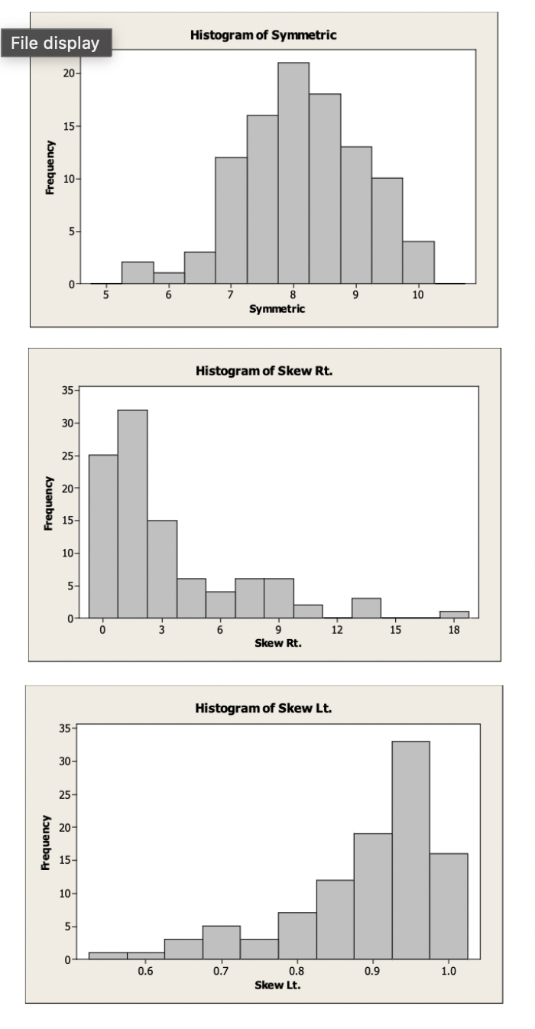
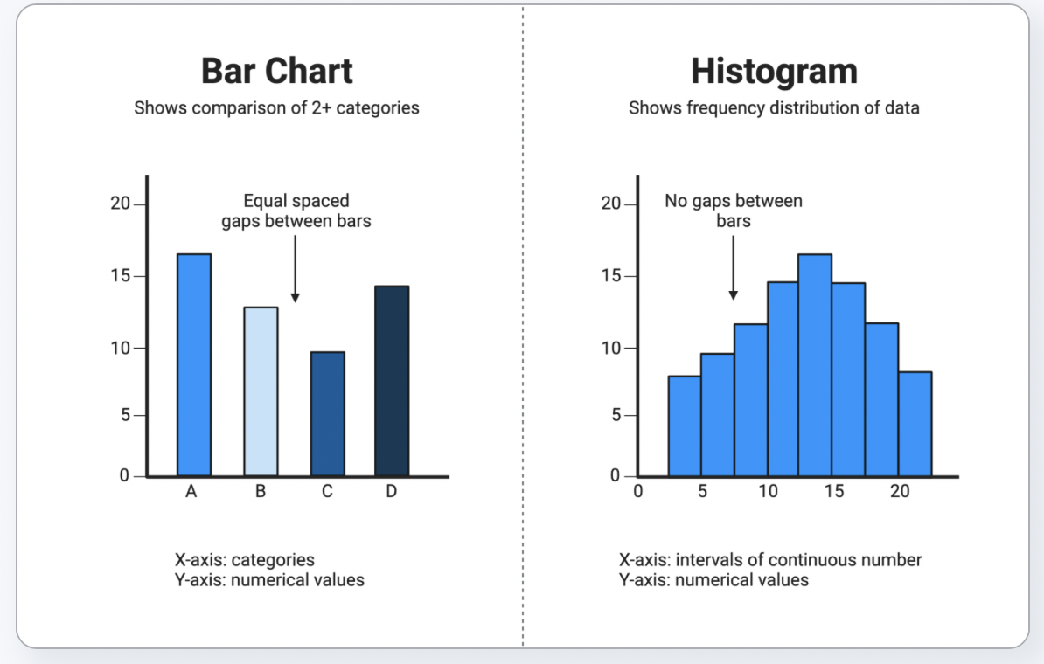
Histograms 2
Interpretation:
Helps visualize skewness:
Right-skewed (positive skew): longer tail on the right.
Left-skewed (negative skew): longer tail on the left.
Symmetric: balanced distribution.
Shows outliers and peaks in the data.
Difference from Bar Plot:
Histograms: Continuous data, no gaps between bars.
Bar Plots: Categorical data, bars with gaps between them.
Data : https://www.biorender.com/template/bar-chart-vs-histogram

Slide 9
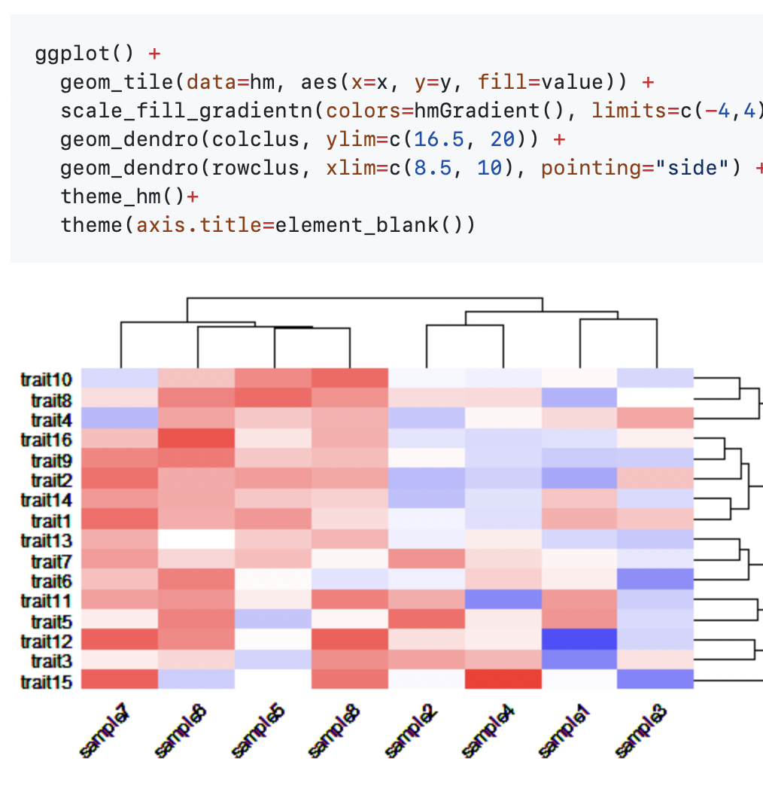
ggplot Dendrograms
Visualizing Hierarchical Clustering Results
Key Features:
Hierarchical Clustering: Data points are progressively merged into clusters based on similarity.
Branches: Represent how clusters are combined, with the length indicating the level of similarity.
Leaves: Individual data points or observations.
Interpretation:
Shorter branches indicate higher similarity between data points or clusters.
Merge height shows the degree of similarity at which two clusters are combined.
Ideal for understanding cluster hierarchy and determining the appropriate number of clusters (by "cutting" the tree).
ggplot2 Use:
Use geom_segment() and geom_text() to build dendrograms from hierarchical clustering results in R.
Data: https://github.com/NicolasH2/ggdendroplot

Slide 10
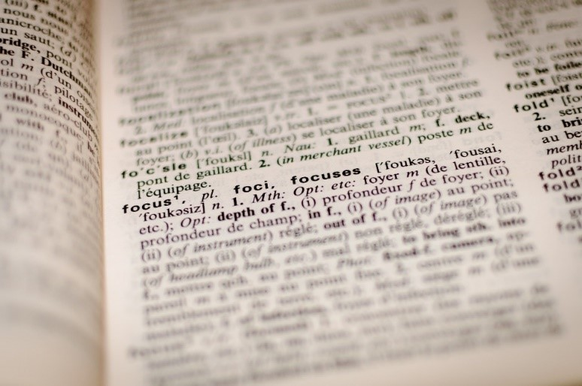
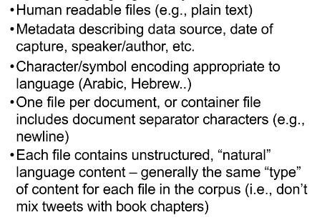
Text Analysis

Slide 11
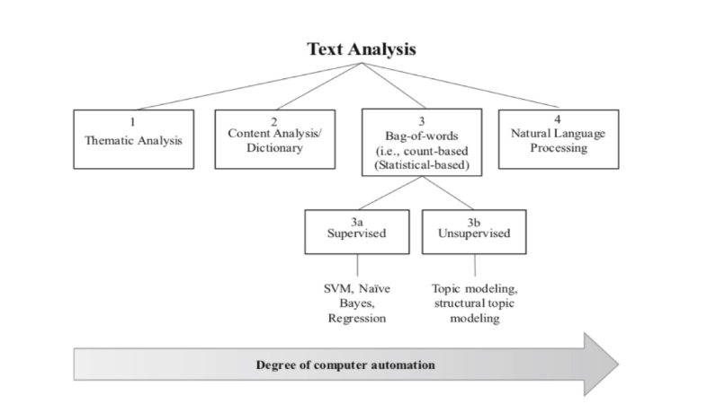

Slide 12
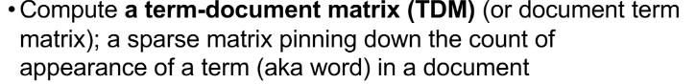
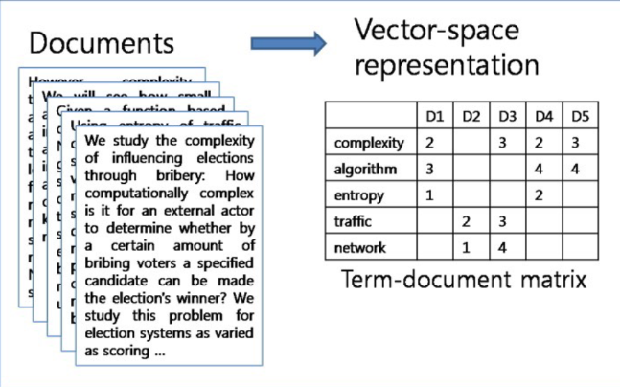

Slide 13
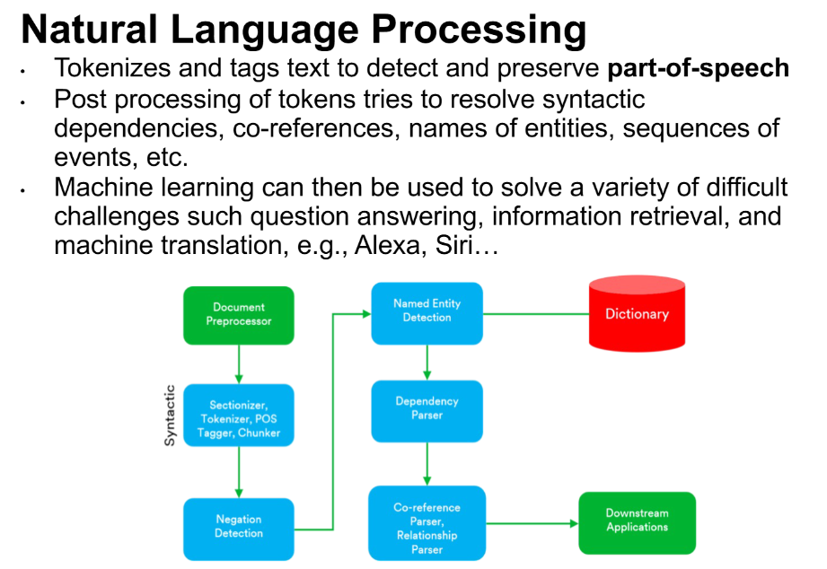

Slide 14
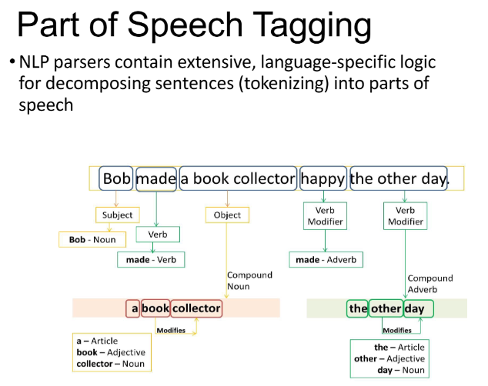

Slide 15
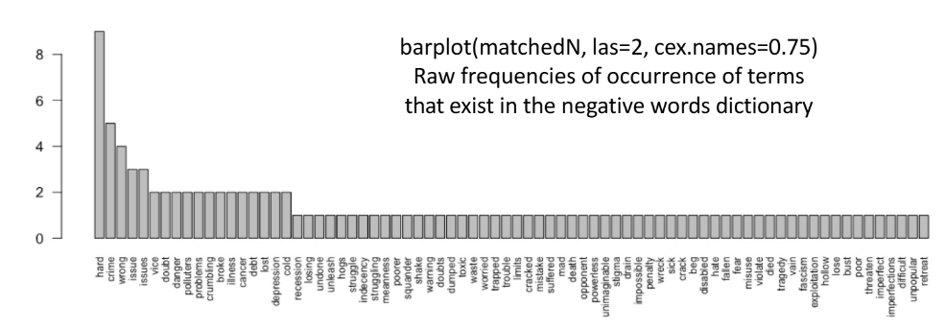
Word Count Bar Plot

Slide 16
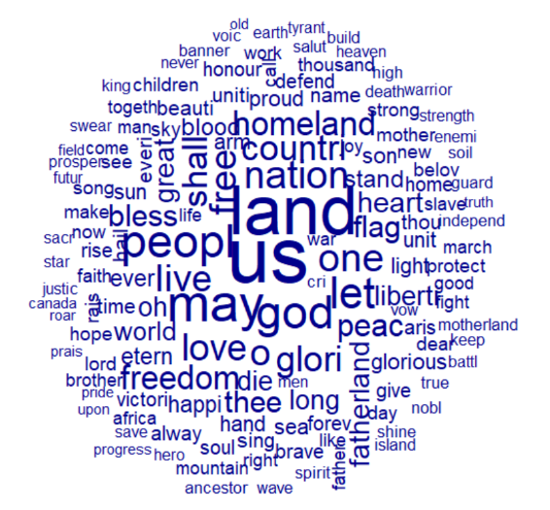
Word Clouds
We used the anthems.csv file to create said word cloud.

Slide 17
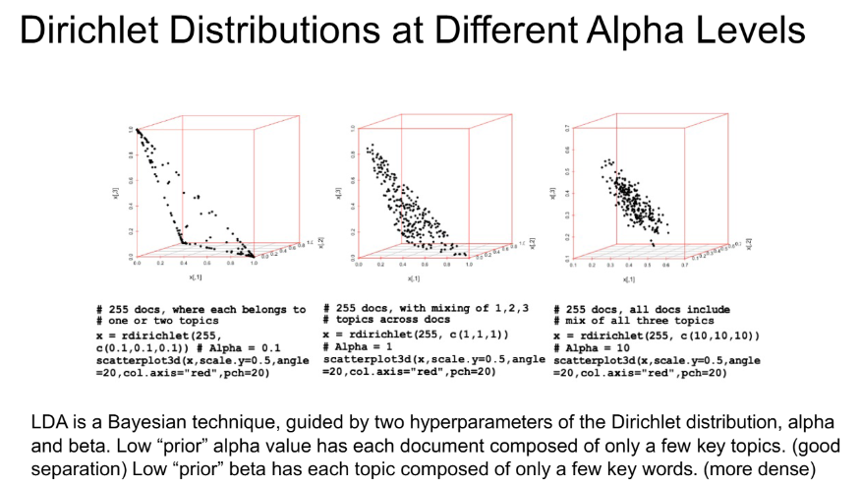

Slide 18
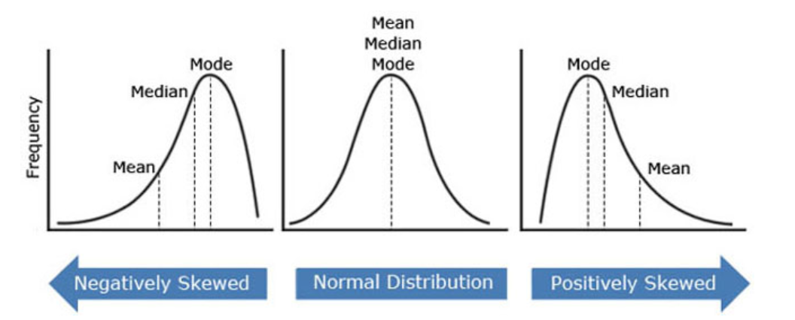
Data Densities and Transformations
Data sets could have one of many different types of distributions! Some include:
Skewed Left The Normal or "Bell" Curve Skewed Right
https://sidneytukramer.blogspot.com/2022/09/skewed-graph.html

Slide 19
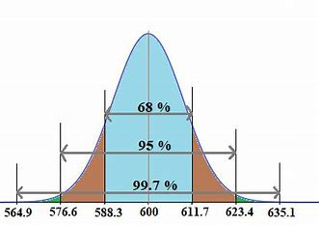
Densities and Transformations: Ideal Distribution
The most ideal distribution to work with is the Normal Distribution!
Allows for the use of many different statistical tests
Eg. T-tests
Allows for Z-score position analysis
Very well-studied
Empirical Rule
Normal Distribution Empirical Rule - Search Images

Slide 20
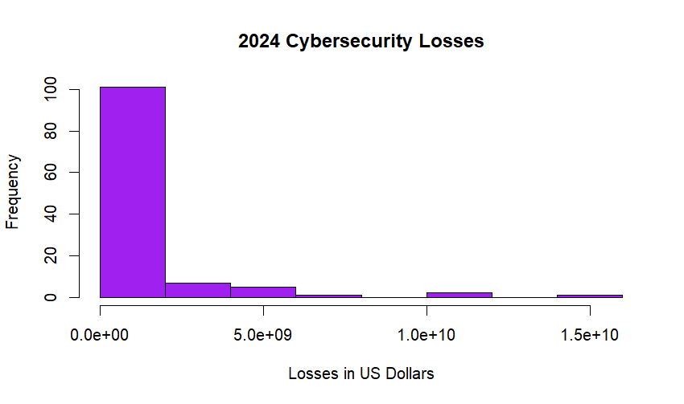
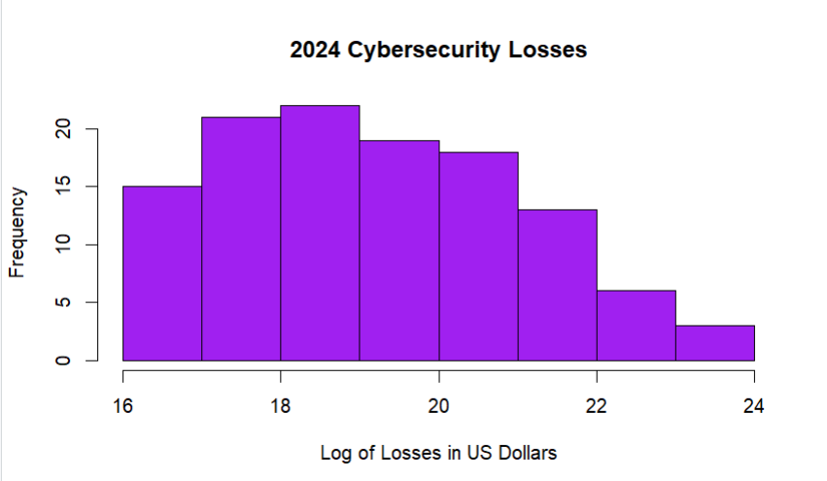
Transformations!
Log transformations: commonly used to normalize heavy left or right skews!
Example using Cybersecurity Incidents Data from Kaggle:
Data:Cybersecurity Incidents Dataset
Log()

Slide 21
More Transformation Options
Distribution | Transformation
Moderate Right Skew | Sqrt(X)
Heavy Right Skew | Log(X)
Right Skew w/non-positive Values | Log(X+c)
Moderate Left Skew | Sqrt(k-X)
Heavy Left Skew | Log(k-X)

Slide 22
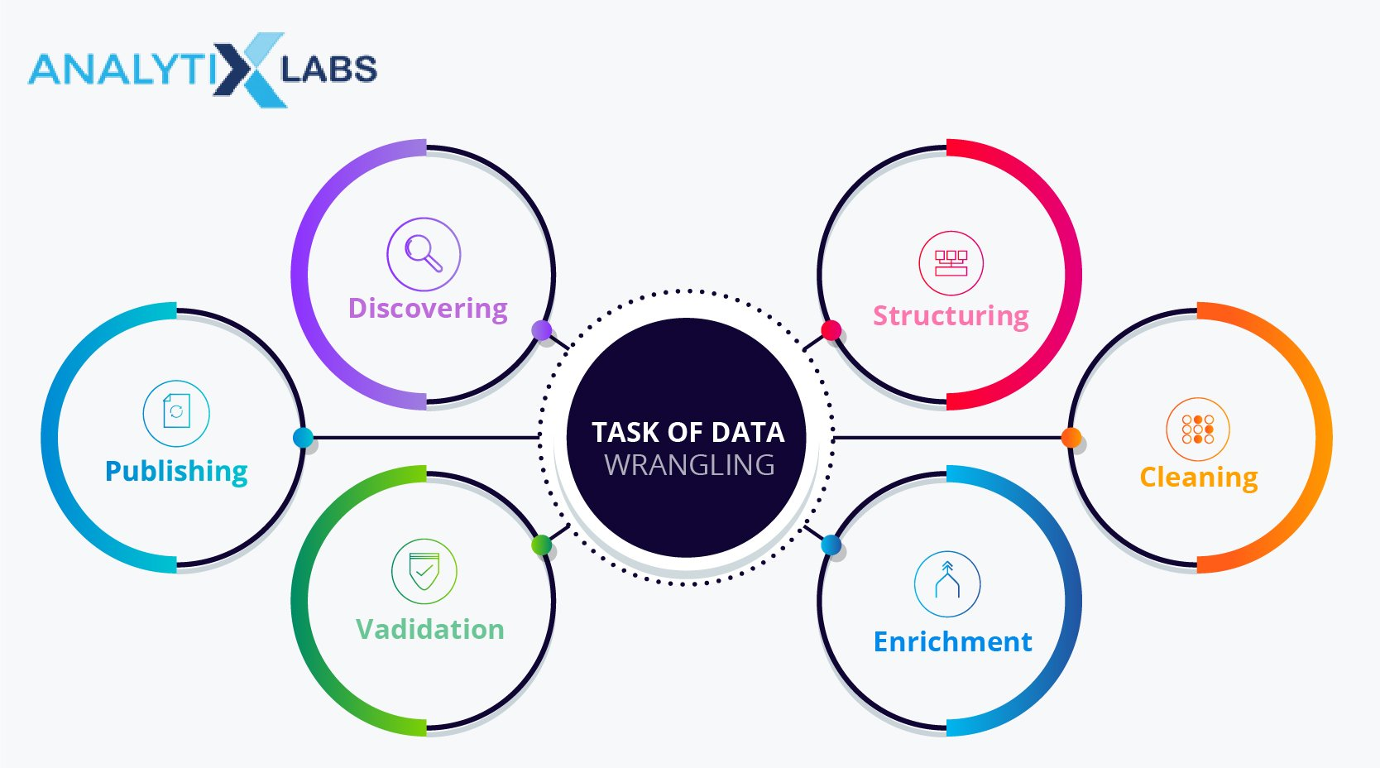
Data Wrangling
In order to properly apply statistical data techniques, we must get the data in a format to properly answer our question
This occurs through manipulations applied to the original downloaded data frame
Often, the dplyr R package is used for such manipulations

Slide 23
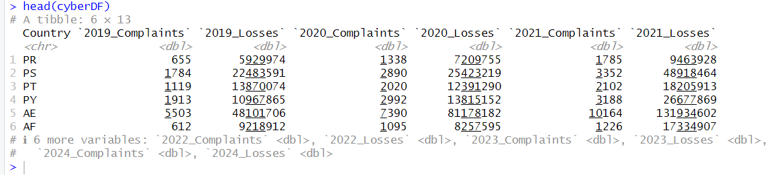
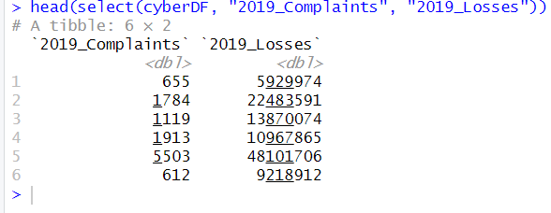
Dplyr Case Study using Cybersecurity Kaggle Data
Method: select
Select subset of columns

Slide 24
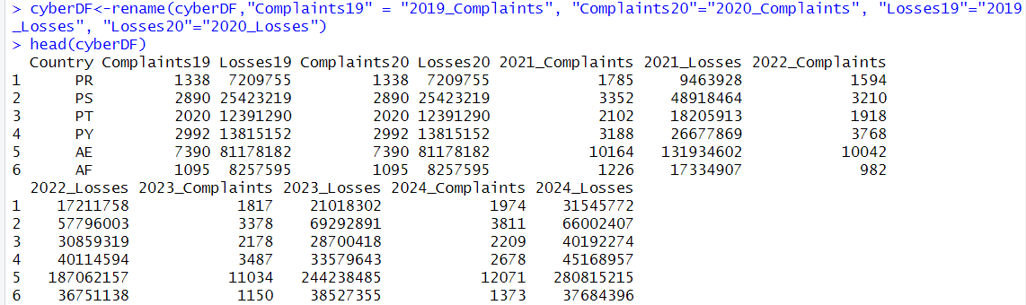
Formatting Data Frames
Rename method

Slide 25
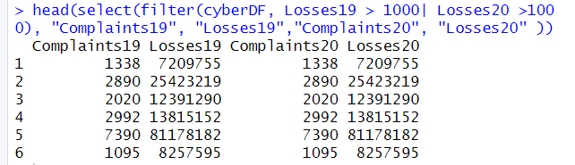
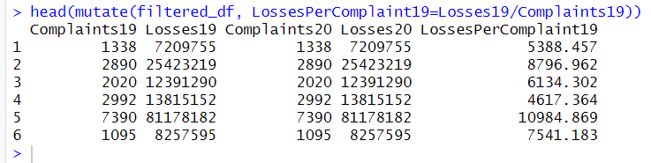
Selecting Columns Using Conditionals
Select and filter with multiple conditions
Mutate Function

Slide 26
More Helpful Dplyr Methods
Method | Purpose
Arrange | Used to sort variables on different columns
Column_to_rownames | Sets the chosen column as your indexing variable
Summarize and Group_by | Summarize-used to calculate statistics such as max, min, mean, and median for groups within the data. Group_by-often used with summarize to determine said "groups" within the data frame

Slide 27
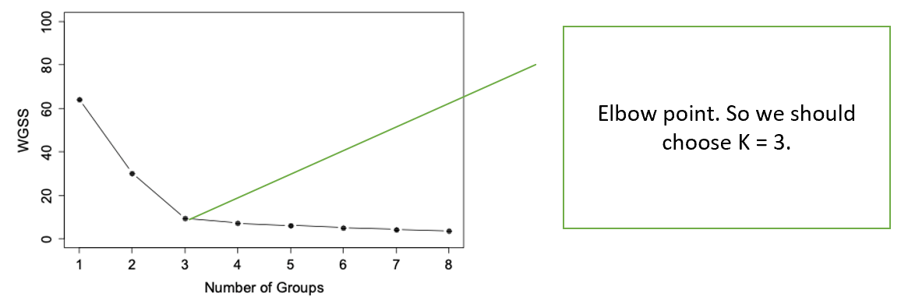
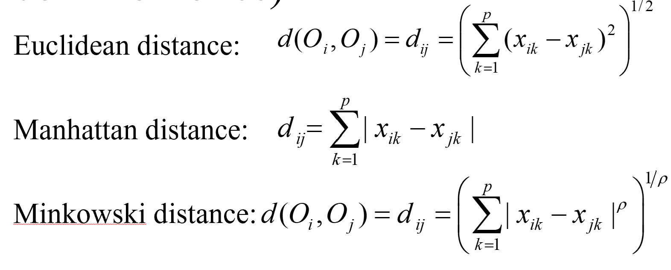
K-means Clustering
Separating Data into common characteristic groupings
Objective :
Minimize within-group distance
Maximize between-group distance
Distance Measures:
Disadvantages:
Specify # of clusters
No categorical vars

Slide 28
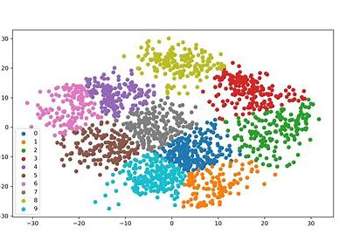

K-means Visuals

Slide 29
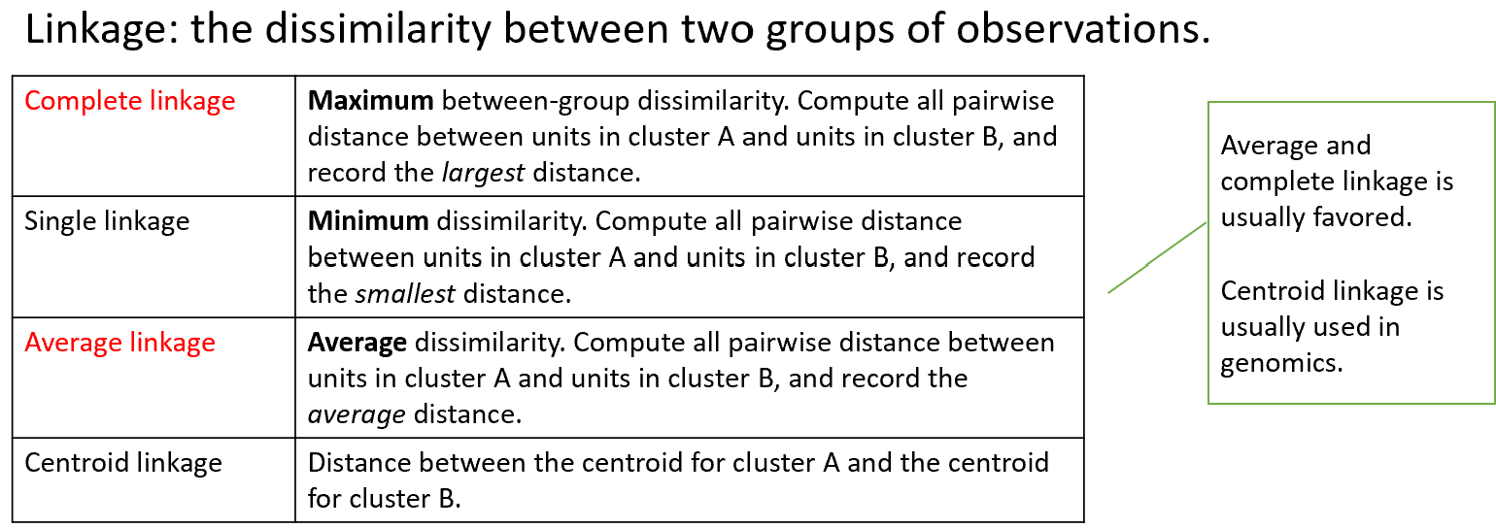
Hierarchical Clustering
Very similar to K-means however...
Can specify distance between groupings
Generates # of groups based on distances

Slide 30
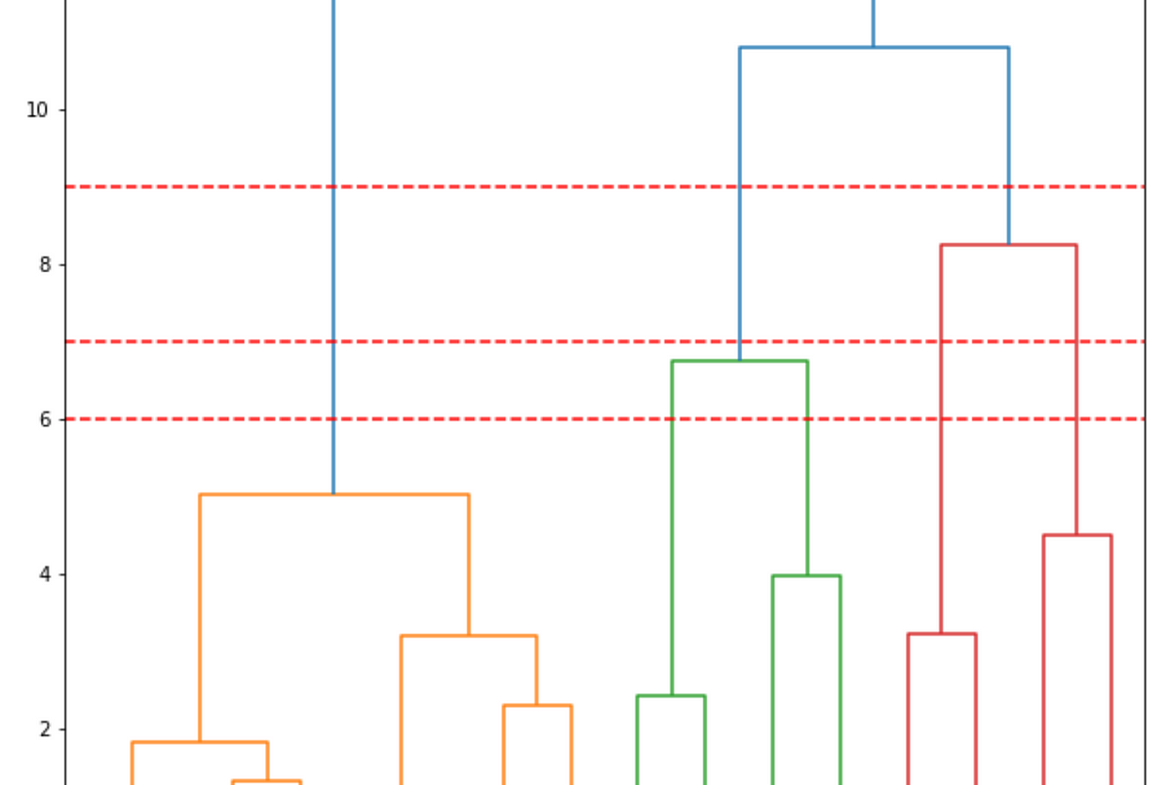
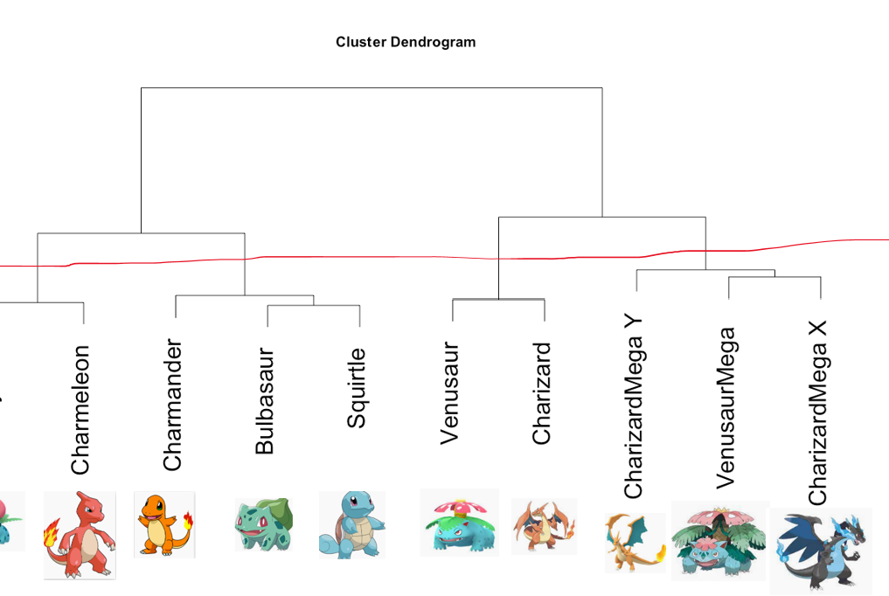
Hierarchical Visuals

Slide 31
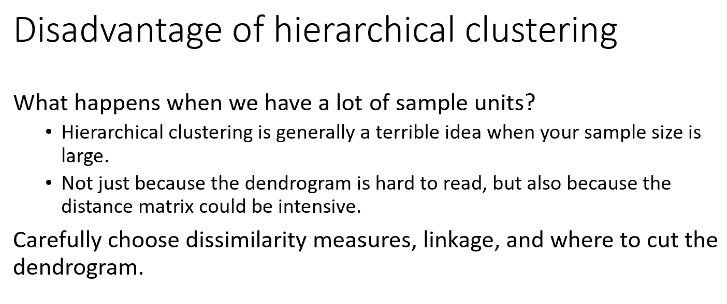
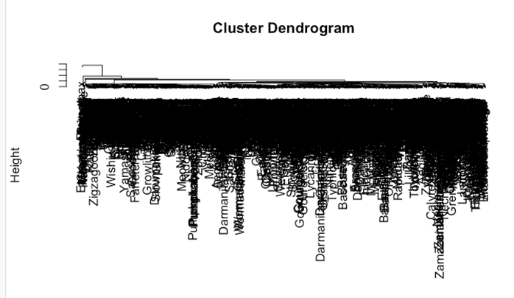

Slide 32
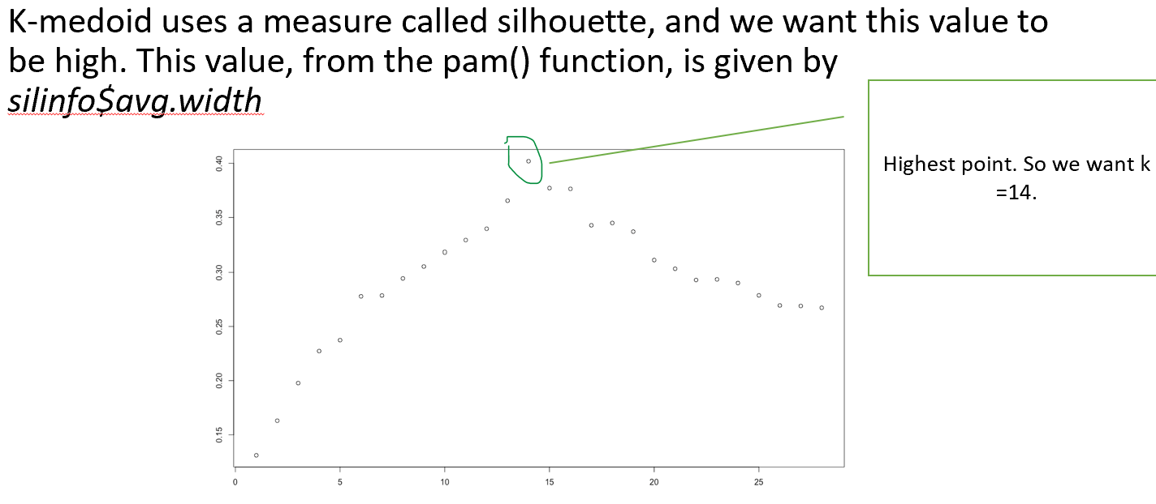
K-medoid Clustering
Ability to incorporate categorical variables
No mean, just a sample unit within each group (medoid)
Gower's Distance

